Slide 1

Thessaloniki .NET Meet up 28/02/2025 Integration Testing with .NET

Slide 2
Speaker details – Charalampos Karypidis
Solutions Architect – remote based at Frontex
Twitter : @xabikos
Github: www.github.com/xabikos
Mail : charalamposkarypidis@outlook.com

Slide 3
Agenda
Integration Testing for ASP.NET applications:
Testing pyramid
WebApplicationFactory
Test Containers
WireMock .NET

Slide 4
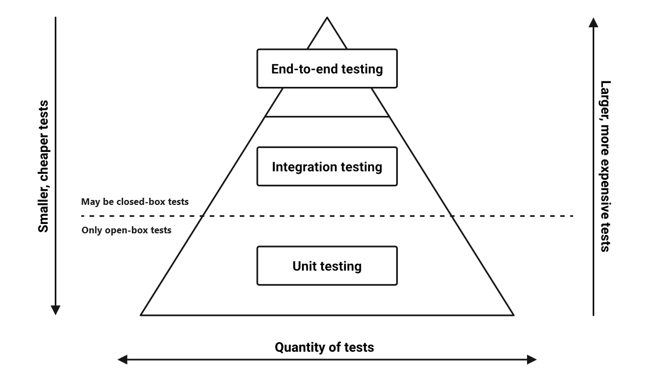
Testing Pyramid
Unit Tests - Focus on a single functionality and small units of code
Integration Tests - Check the interaction between different modules or external systems
E2E Tests - Checking the entire application as end user

Slide 5
Thanks!​
​
​
Any Questions?​

